Slide 1
Capstone Presentation
“LogisticFour”
Computer Engineering
School of Informatics and Telecommunications
Puente Alto Headquarters
2025

Slide 2
Freddy Cardenas
  Jefe de proyecto
Kevin Bustos
  Analista programador
INTEGRANTES DEL PROYECTO
Antonio Martinez
  Administrador BD
Luis Mardones
  Calidad y testing
Mario Silva
  Diseñador

Slide 3
Project Description
Problem or pain
The company Distribuidora Andes Ltda. does not have centralized inventory control, which generates errors, losses and lack of traceability.
Proposed solution
Implement a centralized, real-time Inventory Manager with reports, alerts, and traceability to optimize control and reduce losses

Slide 4
General Objective
Implement a centralized Inventory Manager to reduce losses, optimize time, and ensure reliable information.
Specific Objectives
Being able to manage warehouse and branch inventories and obtain information about the status of products.

Slide 5
Scope
What the System Does:
Real-time inventory control.
Record incoming shipments, outgoing shipments, and transfers.
Generate stock reports and alerts.
Manage user roles and permissions.
Maintain product and supplier traceability.
What it doesn't do:
No gestiona contabilidad ni facturación.
No reemplaza el ERP financiero.
No cubre logística de transporte.
No capacita al personal automáticamente.

Slide 6
List of Functional Requirements
Features
Administrator Manager
Auditor Manager
Warehouse Manager
Supplier Manager
Product Manager
Warehouse Manager
Warehouse Inventory Manager by Warehouse
Branch Manager
Branch Inventory Manager
User Profile Manager
Login
Send Alerts
Submit Reports
View History

Slide 7
List of Non-Functional Requirements
System Features
Web and desktop platform
User-friendly interface: colors, typography, and ease of use
Secure, reliable, and capable of backing up data
Available every day and compatible with all devices
Correct, efficient operation with good interoperability
Optimal performance

Slide 8
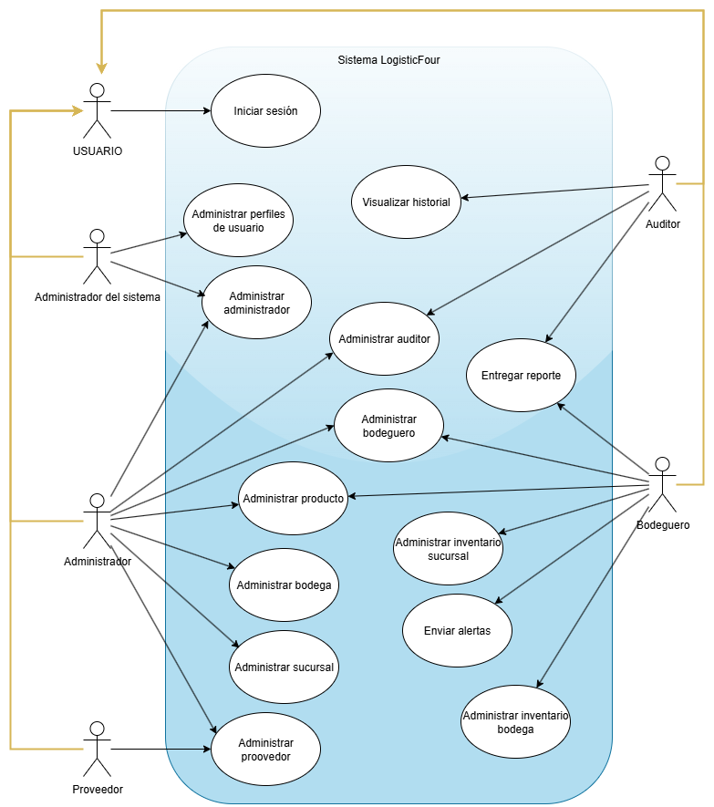
System Design
(Use Case Diagram)

Slide 9
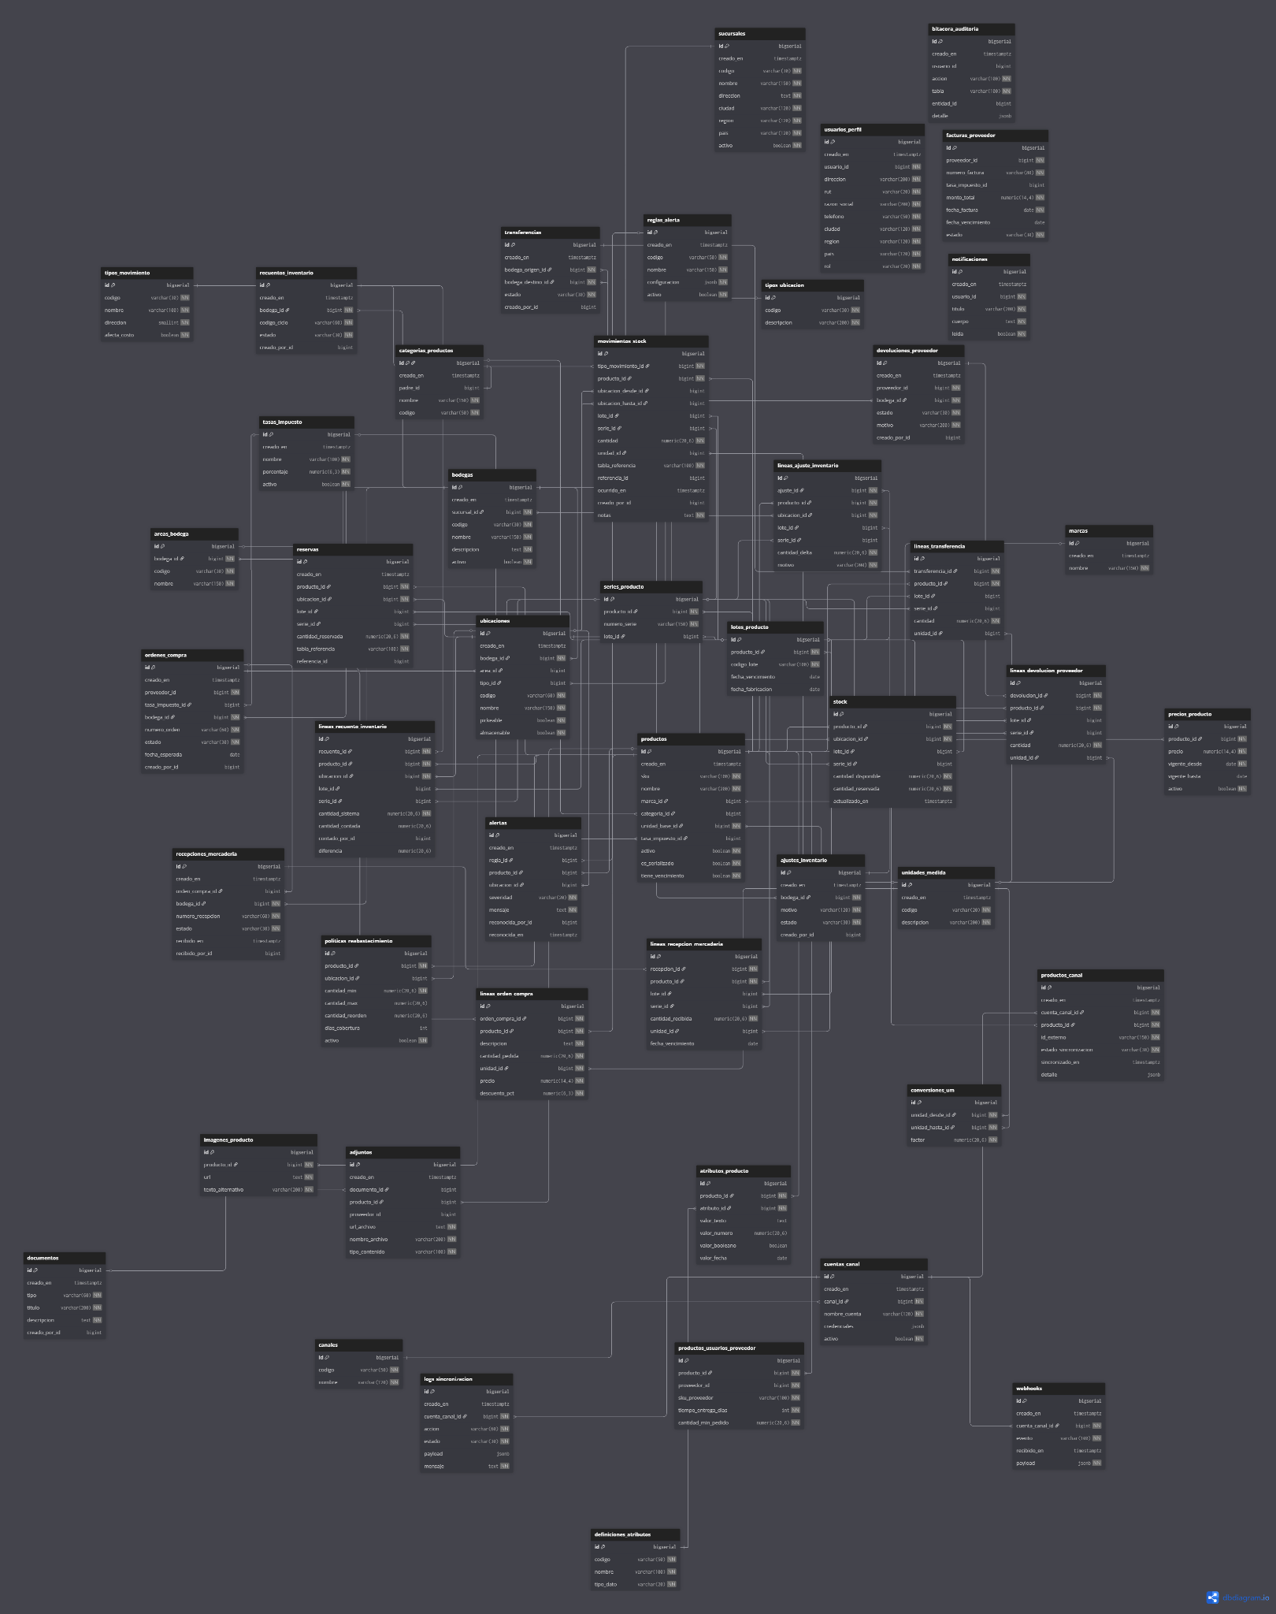
System Design (Relational Model)

Slide 10
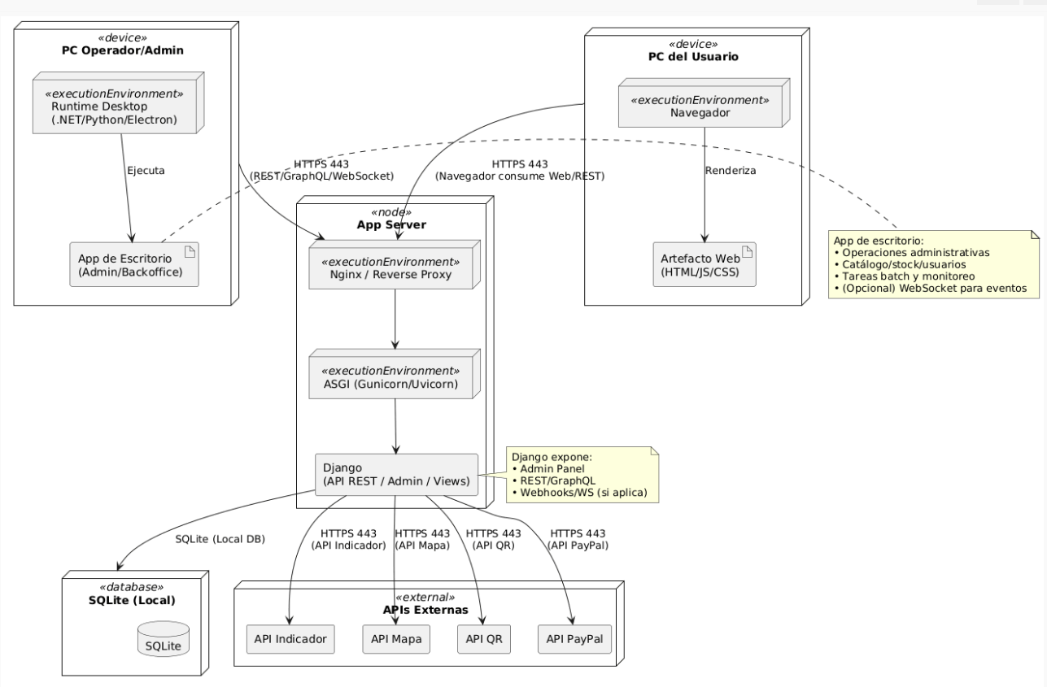
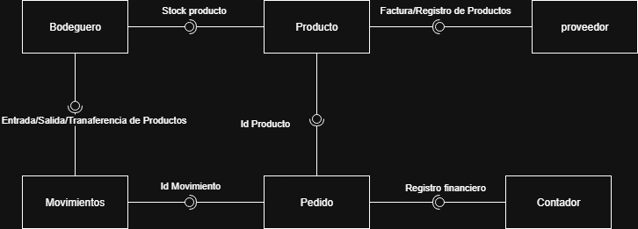
System Architecture
Selected architectural pattern for development and Physical View Diagram:

Slide 11
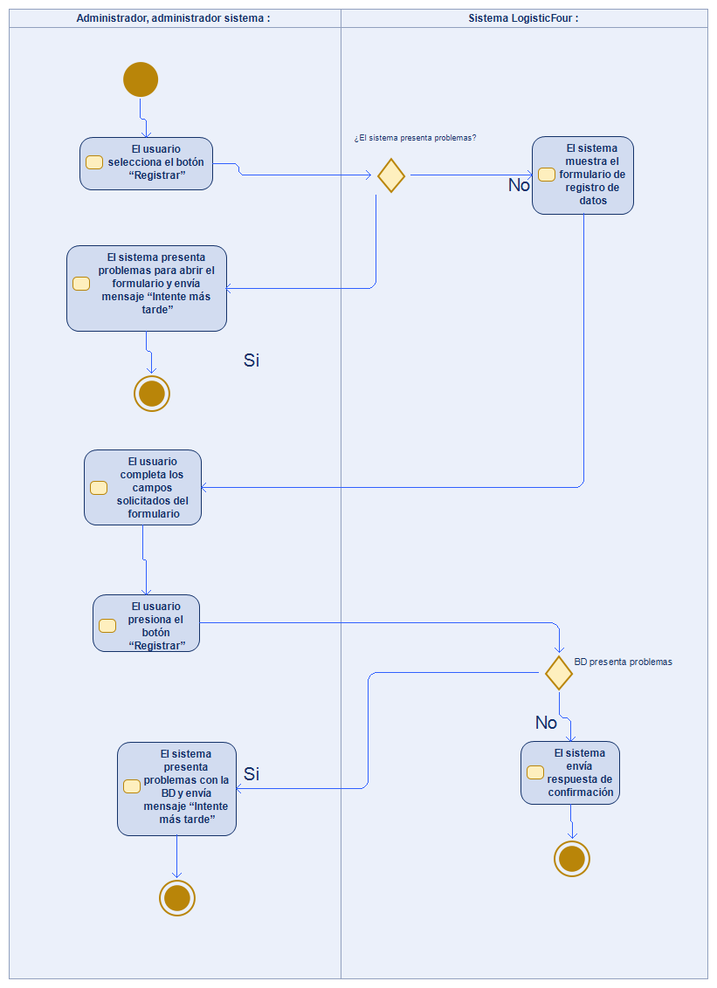
System Architecture
Activity Diagrams

Slide 12
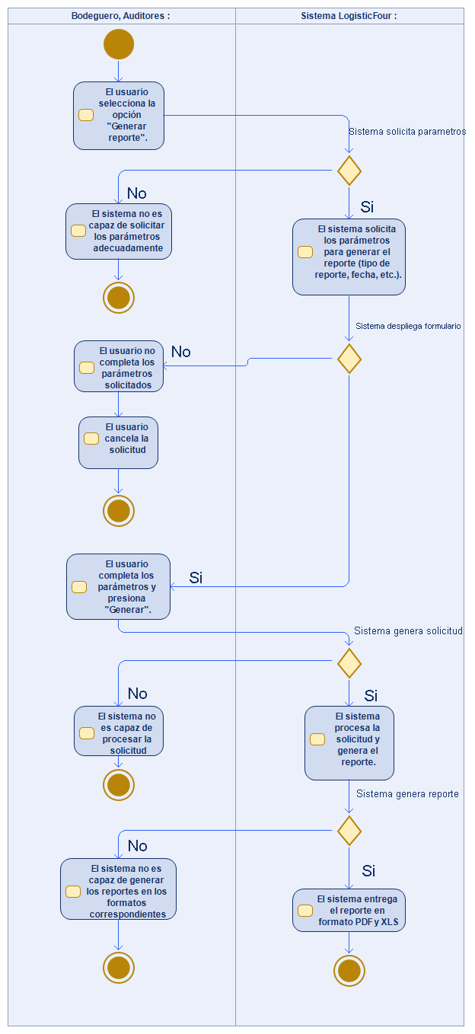
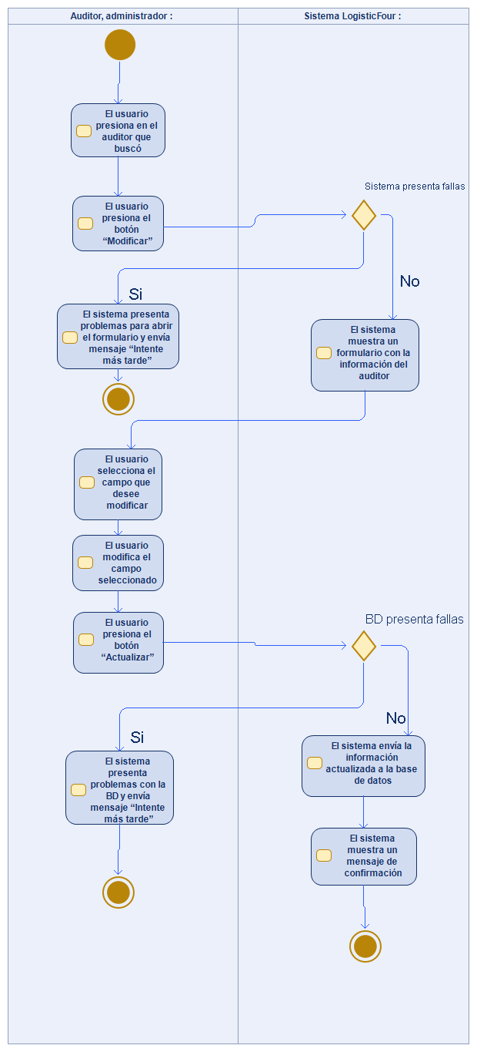
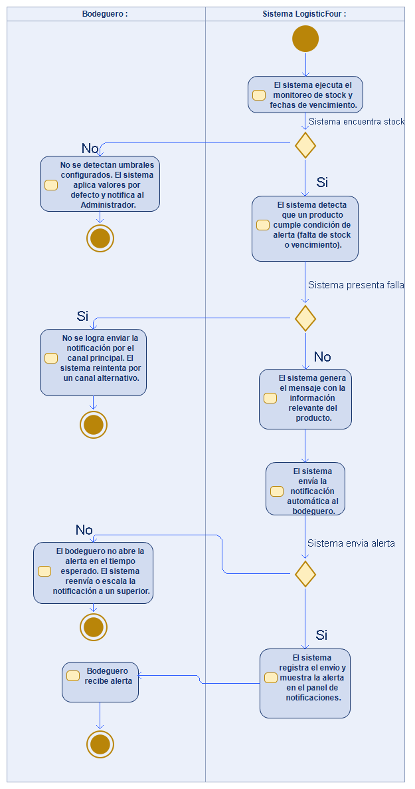

Slide 13
Development Technologies
Programming language: Python (for the backend with Django) and JavaScript (for the frontend interaction).
Framework:
Django: A Python web development framework used for backend creation, database management, authentication, and routing.
Supabase: A backend-as-a-service platform used for real-time database management, user authentication, and file storage.
Database: PostgreSQL, managed by Supabase for structured storage and real-time queries.
Operating system: Compatible with Windows 10 Pro 64-bit for development and deployment.
Development environment: VS Code or PyCharm as editors, with virtualization tools such as Docker if needed.
Versioning: Git for version control and GitHub for collaboration and deployment.
Format support: The system supports exporting and importing PDF and XLS files.

Slide 14
Planning
Timeline of significant project milestones
Phase Name | Dates
Phase 1 - Project Definition | 10/09/2025
Phase 2 Part 1 - Project Development Documentation | 08/10/2025
Phase 2 Part 2 - Project Development | 05/11/2025
Phase 3 - Project Presentation | 03/12/2025

Slide 15
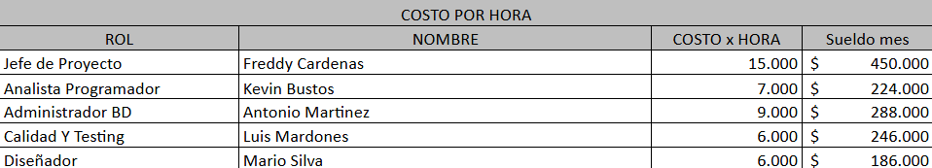
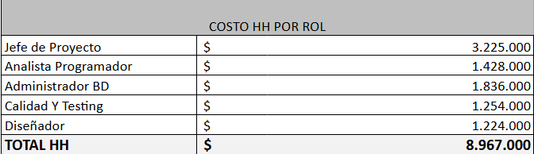
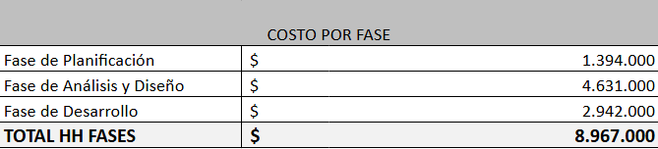
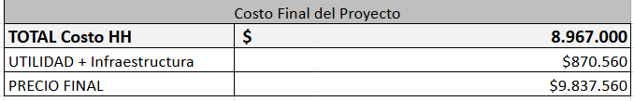
Summary of Estimated Project Costs

Slide 16
Live presentation of the developed system

